Slide 1
Information
Notes
Make the session interactive by using resources like the quiz.
Tailor your approach to your audience: – Are there any examples of knife crime in their local area? (Do not use real names)
Use the real life case studies: Show the videos and allow questions.
Encourage open discussion throughout to make sure the participants are engaged.
Evidence has shown shocking and graphic content does not work and can sensationalise. Presenters can use emotion to convey content rather than shock.
Resources required: Post it notes, pens. Flip chart. IT (Laptop, projector, screen)

Slide 2
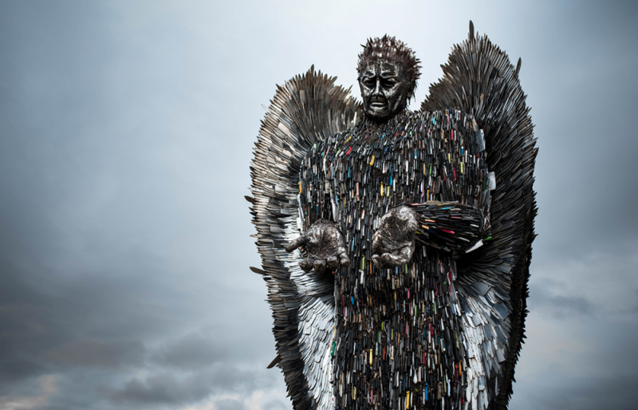
#NOT THE ONE CAMPAIGN
Year 8+
#NotTheOne

Slide 3
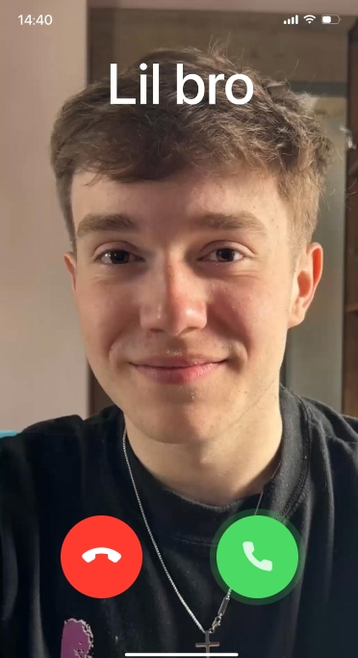

#NotTheOne
You have a say in your future. Make it one that’s free from knives.
Carrying a knife won’t keep you safe. In fact, statistics show that you are more likely to get hurt.
A different future, free from knives, is possible one with opportunities, security and hope.
#NotTheOne

Slide 4
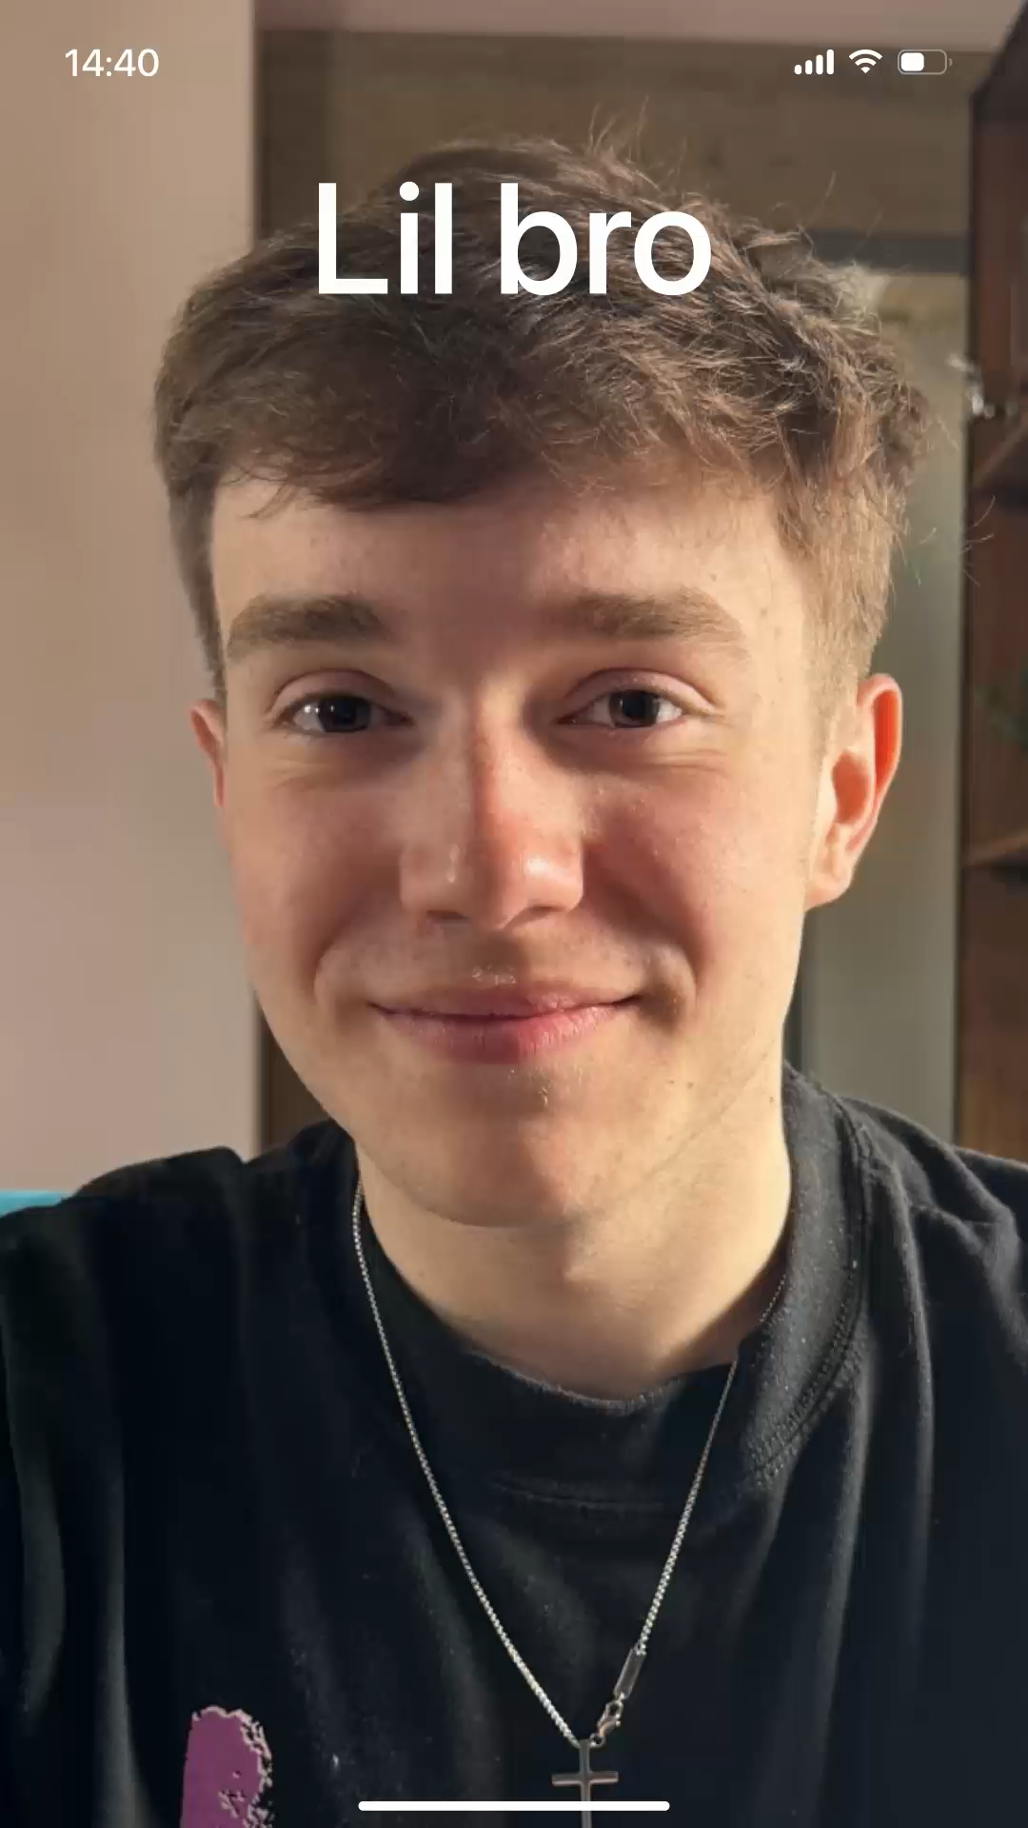
#NotTheOne

Slide 5

True
or
False
#NotTheOne
Notes:
Spilt into groups

Slide 6
Question 1
Carrying a knife for self-defence is legal in the UK?
#NotTheOne
Notes:
Further information:
Self-defence is never an acceptable reason to carry an illegal weapon under UK law

Slide 7
Question 2
Only 1-in-10 young people carry a knife in the UK.
#NotTheOne
Notes:
Further information:
However, it is always illegal to buy and sell an illegal weapon regardless of your age and this DOES NOT MAKE IT SAFER it makes it more likely to be a victim of crime.

Slide 8
Question 3
Carrying a knife makes you safer.
#NotTheOne
Notes:
Further information:
However, it is always illegal to buy and sell an illegal weapon regardless of your age and this DOES NOT MAKE IT SAFER it makes it more likely to be a victim of crime.

Slide 9
Answers
Carrying a knife for self-defence is legal in the UK?
FALSE
Only 1 in 10 young people carry a knife in the UK
TRUE
Carrying a knife makes you safer.
FALSE
#NotTheOne

Slide 10
Participant Activity: Know the facts
Listen
Discuss
Ask and answer questions
#NotTheOne
Notes:
Ensure class are all okay and thank them for engaging in a difficult theme.
Share the helpline services and charities on the final slide
Consider sharing with your Senior Management team any concerns about individuals upset or concerned by the session

Slide 11
It is illegal to carry an offensive weapon like a knife in a public place without a “good reason”, even if you don’t intend to use it.
The maximum penalty for carrying a knife illegally is either four years in prison, an unlimited fine, or both.
A good reason for carrying a knife can include if it is a trade tool, for religious reasons, or a pen knife less than three inches long.
However, possessing a legal knife becomes illegal if it is used to cause injury or harm.
Police can stop and search anyone they believe is carrying a weapon.
You don’t have to just stab someone to have broken the law. Under ‘Joint Enterprise’ you could end up in prison for assisting or encouraging someone to commit a knife crime.
#NotTheOne
Notes:
6 groups 2 statements each, but each group will only feedback on one.
Get them to consider
Do they think the statements are fair.
What are the consequences of the the statements? To make us safer

Slide 12
Facts about young people and knife crime.
#NotTheOne

Slide 13

Although knife crime receives a lot of media coverage, only 1-in-1000 young people in Devon & Cornwall carry a knife (Devon & Cornwall Police data 2024)
#NotTheOne

Slide 14

There is no “safe” place to stab someone.
#NotTheOne

Slide 15
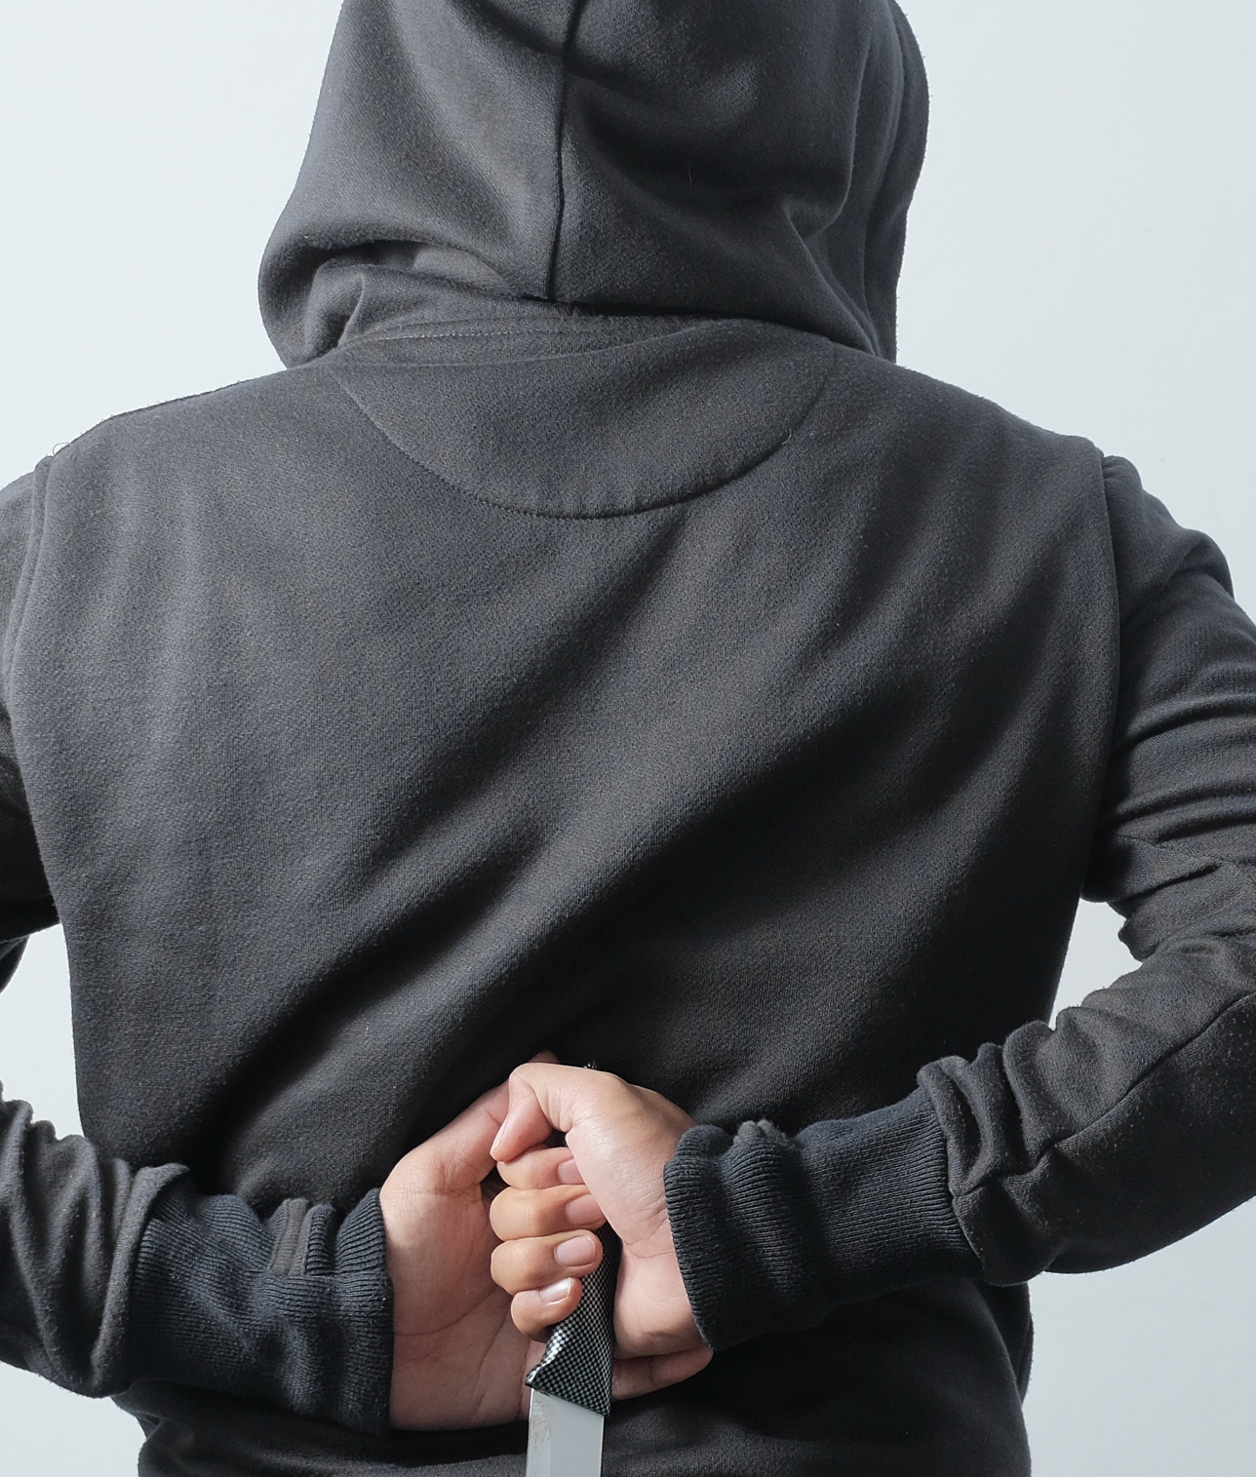
Young people carry knives for self-defence or due to safety concerns.
#NotTheOne

Slide 16

Some young people carry knives because they’ve been pressured to do so, to gain credibility among peers, or to intimidate others.
#NotTheOne

Slide 17
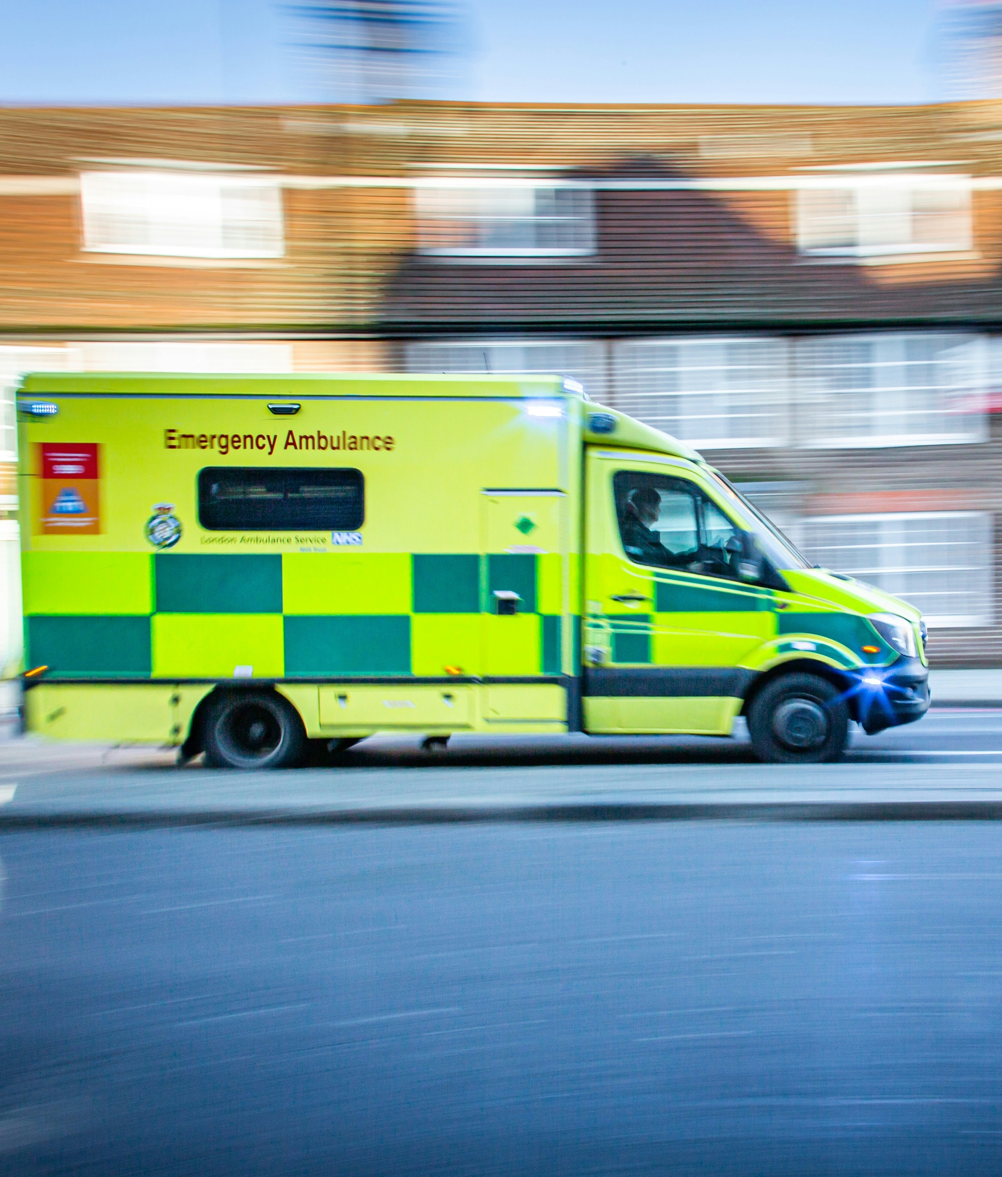
In some parts of the UK, you are statistically more likely to get stabbed by your own knife than someone else’s.
#NotTheOne

Slide 18
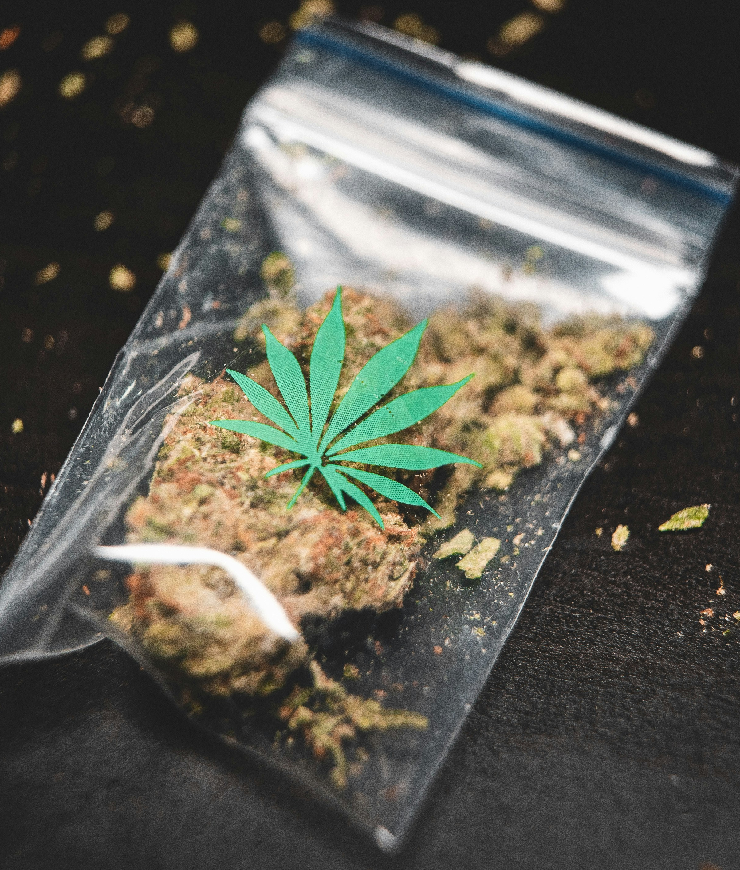
Many instances of knife crime are related to criminal activity like the drug trade. Criminal gangs may even exploit a young person to get involved in their activities, like so-called ‘County Lines’.
#NotTheOne

Slide 19

If you have a criminal record, you may not be able to visit other countries, (i.e. The United States)
#NotTheOne
#NotTheOne

Slide 20

It will impact on your ability to go to college and affect a job application. It will also show on DBS if you have been involved in a crime.
#NotTheOne

Slide 21

BBC report: Knife crime has risen by 9% across the UK. Why are more youths carrying Knives
#NotTheOne

Slide 22
Are you worried about a friend who maybe carrying a knife?
Changes in behaviour: Sudden or significant changes in behaviour, such as becoming withdrawn, aggressive, or secretive.
Changes in friendships and associations: If a young person starts associating with new friends and groups you haven’t heard of or met before.
Academic performance: A sudden drop in academic performance or engagement in school can also be an indicator.
#NotTheOne
Notes:
However, it’s important not to jump to any conclusions even if you spot these signs. This pack includes a guide to speaking to a young person about knife crime that can help you broach the subject if you’re concerned

Slide 23






Support and guidance
0808 808 5000
0808 800 2222
Resources and guidance
Guidance and support
Support helpline
Confidential support
Information and advice
Support and information
#NotTheOne

Slide 24

Year 8+
Write down the most important thing you have learned from this session.
#NotTheOne
Notes:
Post it notes required

Slide 25
Questions
#NotTheOne

